Slide 1
IBM University Engagement Project Submission
“Exploring the Power of Agentic AI with IBM Granite and IBM Bob”

Slide 2
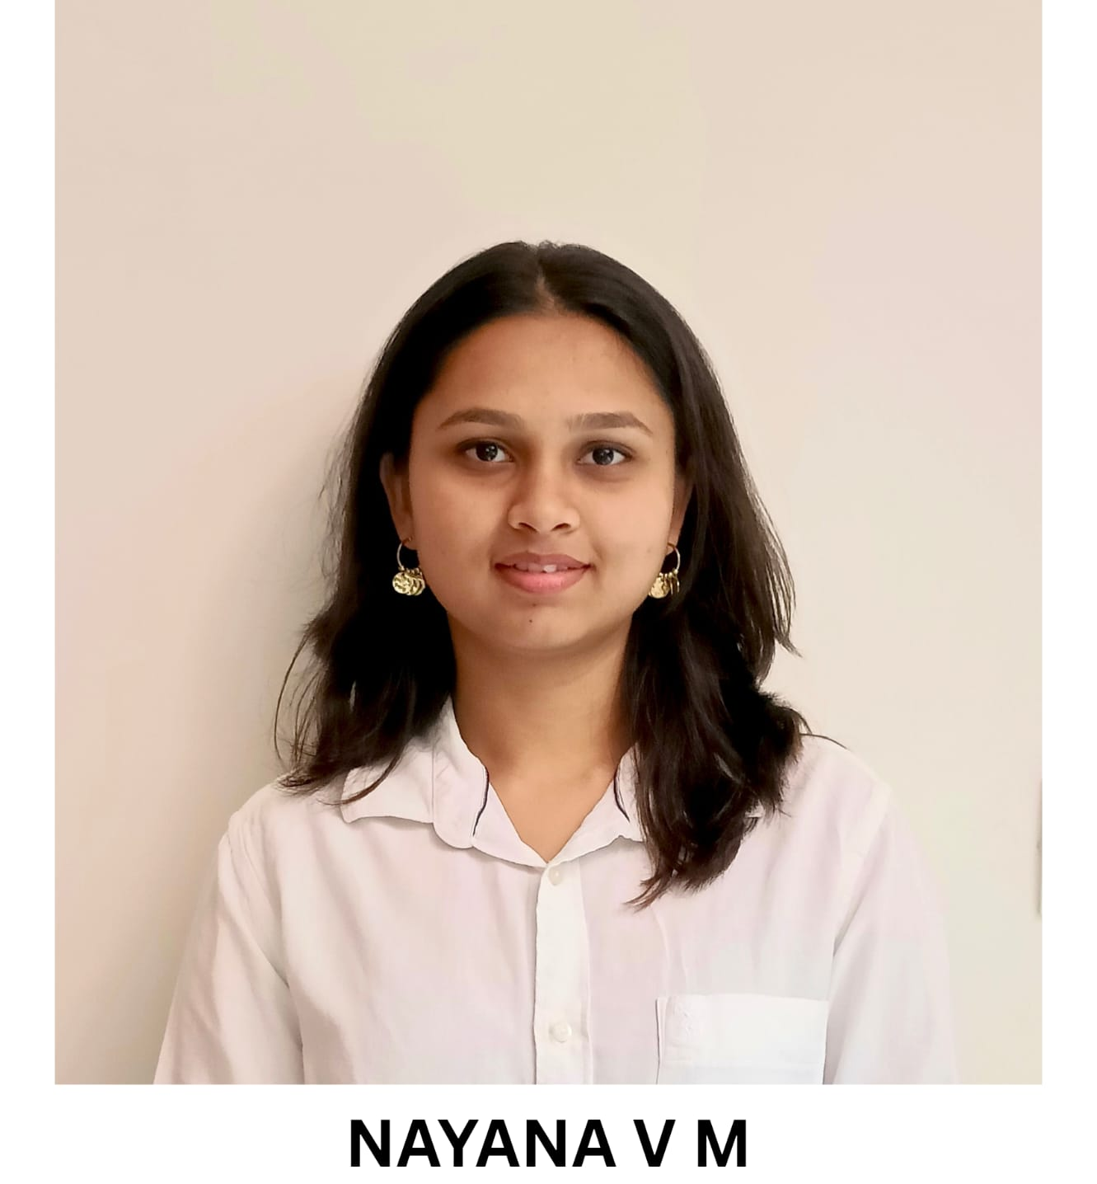
Project Tile – FinLitBot – AI Agent for Digital Financial Literacy & Cyber Fraud Prevention
Domain of Project – FinTech / Cyber Security / Public Welfare
Student Name | Recent Passport Photo | Email ID | Mobile number [WhatsApp]
Nayana V M |  | nayana.vm.2026@gmail.com | 6361899393

Slide 3
Problem Statement -
Problem Statement : AI Agent for Digital Financial Literacy
The Challenge
Digital payment adoption via UPI in India has grown rapidly, leading to increased exposure to cyber fraud, phishing links, fake loan apps, and APK malware. Citizens often lack immediate, accessible guidance during unauthorized transactions, resulting in delayed reporting and lost funds
The Objective
Build an AI-powered Digital Financial Literacy Agent that provides real-time fraud defense and financial literacy guidance for digital payment users. The solution should:
UPI Scam Protection – Verify suspicious collect requests and QR codes while enforcing the rule to never enter a PIN to receive money.
Financial Safety RAG Retrieval – Ground advice in verified guidelines from RBI, NPCI, and official cybercrime portals.
Incident Triage & Helpline 1930 – Guide users through immediate Golden Hour bank freezes and cyber helpline reporting protocols.
Safe Lending Advisory – Verify RBI-registered lenders and calculate transparent loan EMIs to avoid predatory loan traps.
Multi-Agent System –
UPI Sentinel Agent (payment safety and scam verification)
Fraud Response Agent (emergency 1930 triage and fund freeze steps)
Lending Advisory Agent (lender verification and EMI calculations)
Financial Literacy Agent (budgeting principles and credit score guidance)
Visualization Dashboard – Provide a responsive web portal featuring real-time chat, threat telemetry, and an interactive EMI planner.

Slide 4
Proposed Solution -
Proposed Solution: AI-Powered Digital Financial Literacy Agent
The proposed solution is a multi-agent AI-powered financial protection and literacy copilot built using IBM Bob, IBM watsonx.ai, and Granite Models (ibm/granite-3-8b-instruct) to provide real-time fraud defense, payment safety verification, and financial guidance. The system addresses vulnerabilities in digital banking, phishing exposure, and predatory lending through an intelligent, modular architecture.
At its core, the solution uses a Retrieval-Augmented Generation (RAG) pipeline grounded in verified regulatory frameworks from the Reserve Bank of India (RBI), NPCI, and the National Cyber Crime Reporting Portal. This ensures the agent delivers accurate, legally compliant security guidance and prevents misleading financial advice.
The system consists of four key agents:
UPI Sentinel Agent: Evaluates transaction requests, checks QR codes, and prevents fraud by strictly enforcing that a UPI PIN is never required to receive money.
Cyber Fraud Triage Agent: Provides immediate incident support during unauthorized debits, guiding users through the critical Golden Hour protocol, bank freezes, and Helpline 1930 reporting.
Safe Lending Advisory Agent: Assists users in verifying RBI-registered NBFCs against illegal loan apps and provides an automated calculator for transparent loan EMI analysis.
Financial Literacy Agent: Educates users on foundational money management, including the 50/30/20 budgeting principle and maintaining a healthy CIBIL credit score.
The solution includes a user-friendly dashboard (built with Python Flask, HTML5, and modern CSS) that visualizes threat telemetry, provides quick-action safety prompts, and includes an interactive loan calculator.
IBM Bob is used to scaffold and orchestrate the agent workspace, while watsonx.ai ensures scalable model deployment, inference, and AI governance. IBM Granite models power the reasoning, intent classification, and advisory generation.

Slide 5
Technology Used
IBM Bob platform – Used for scaffolding, full-stack code generation, and structuring the modular agent architecture.
IBM Granite model (ibm/granite-3-8b-instruct) – Powers natural language understanding, intent classification, scam reasoning, and empathetic financial advisory responses.
IBM Cloud – Provides the cloud infrastructure, IAM OAuth authentication, and secure REST endpoints to run and scale the FinLit Agent reliably.
Retrieval-Augmented Generation (RAG) – Grounded in verified banking regulations and NPCI safety protocols before generating answers, preventing financial hallucinations and ensuring advice is legally sound.
IBM watsonx.ai – Manages foundation model inference, runtime parameters, token governance, and prompt optimization.
Domain Knowledge Base / Security Store – Stores official RBI guidelines, common fraud signatures (fake electricity bill APKs, fraudulent QR codes), and National Cyber Crime Helpline (1930) procedures for real-time retrieval.

Slide 6
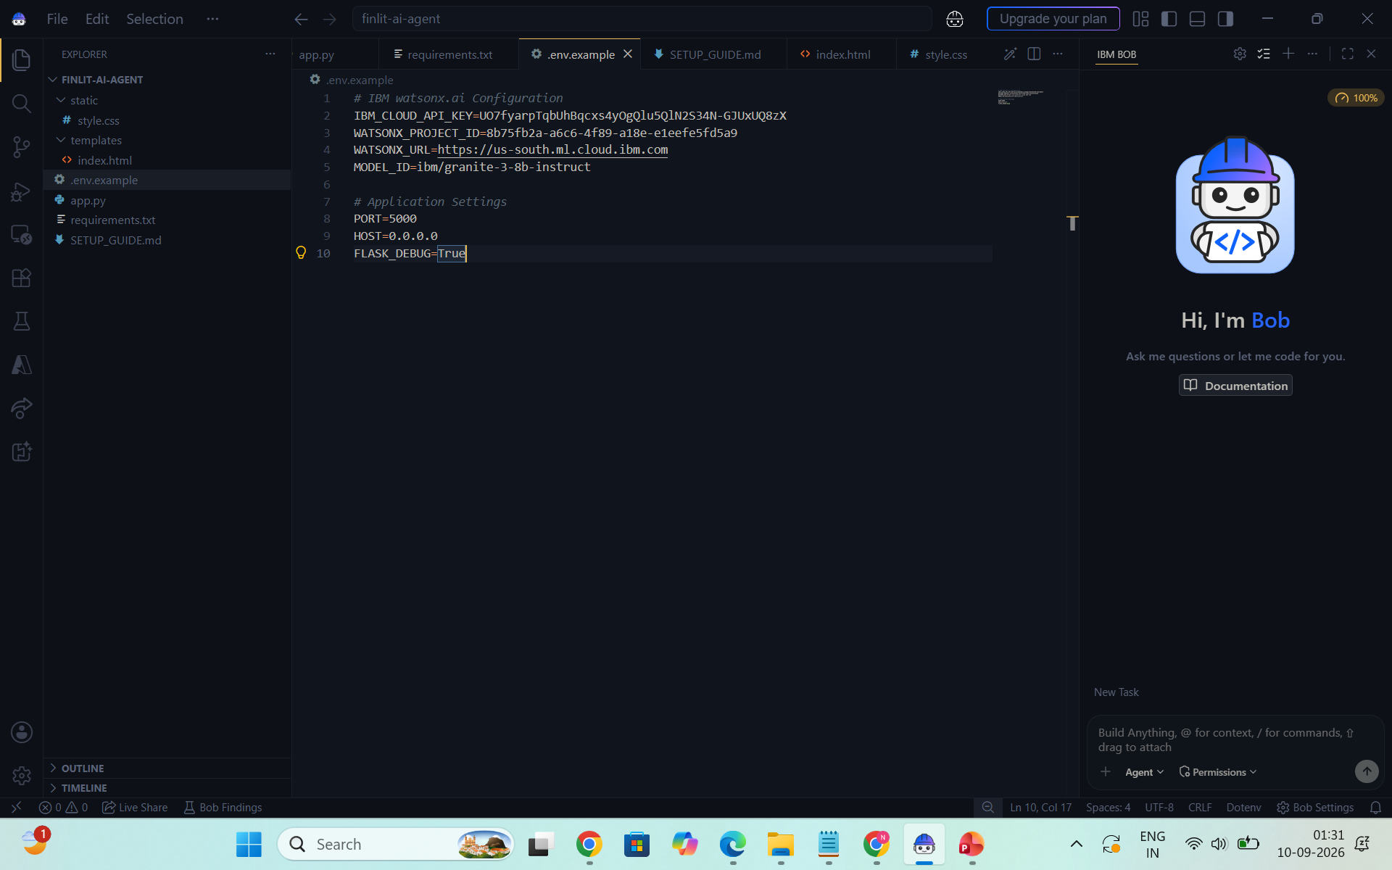
Required Files created using IBM bob -
App.py
Requirements.txt
Style.css
.env
Index.html

Slide 7
IBM Bob Screenshots:

Slide 8
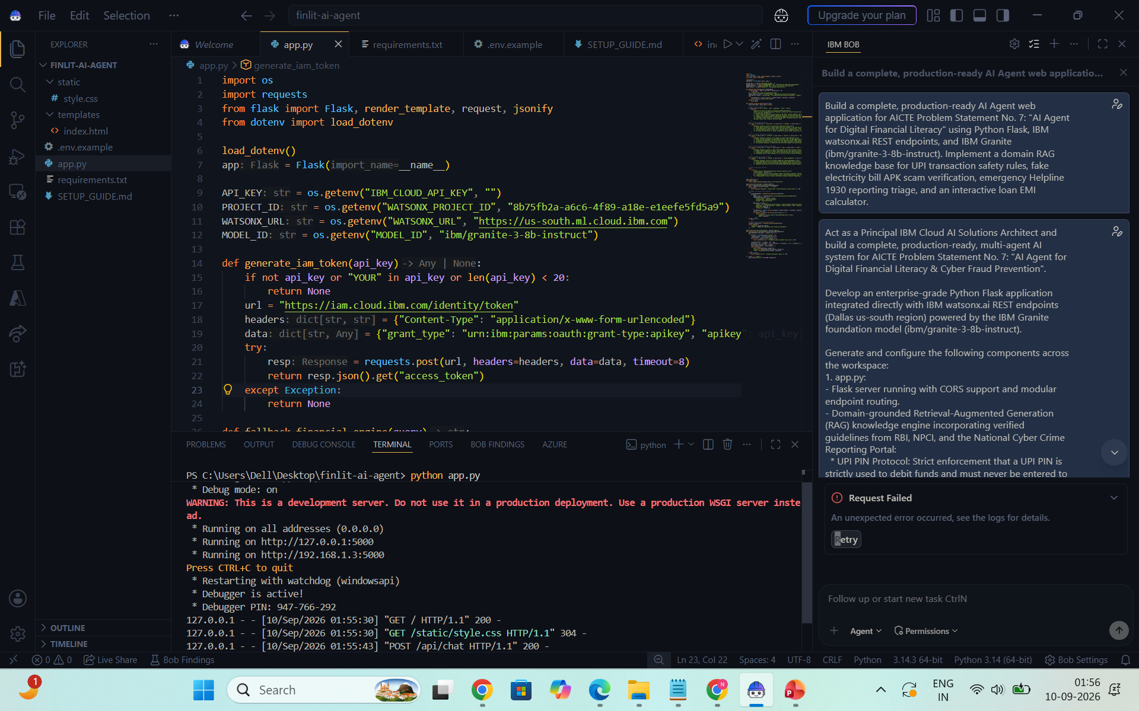

Slide 9
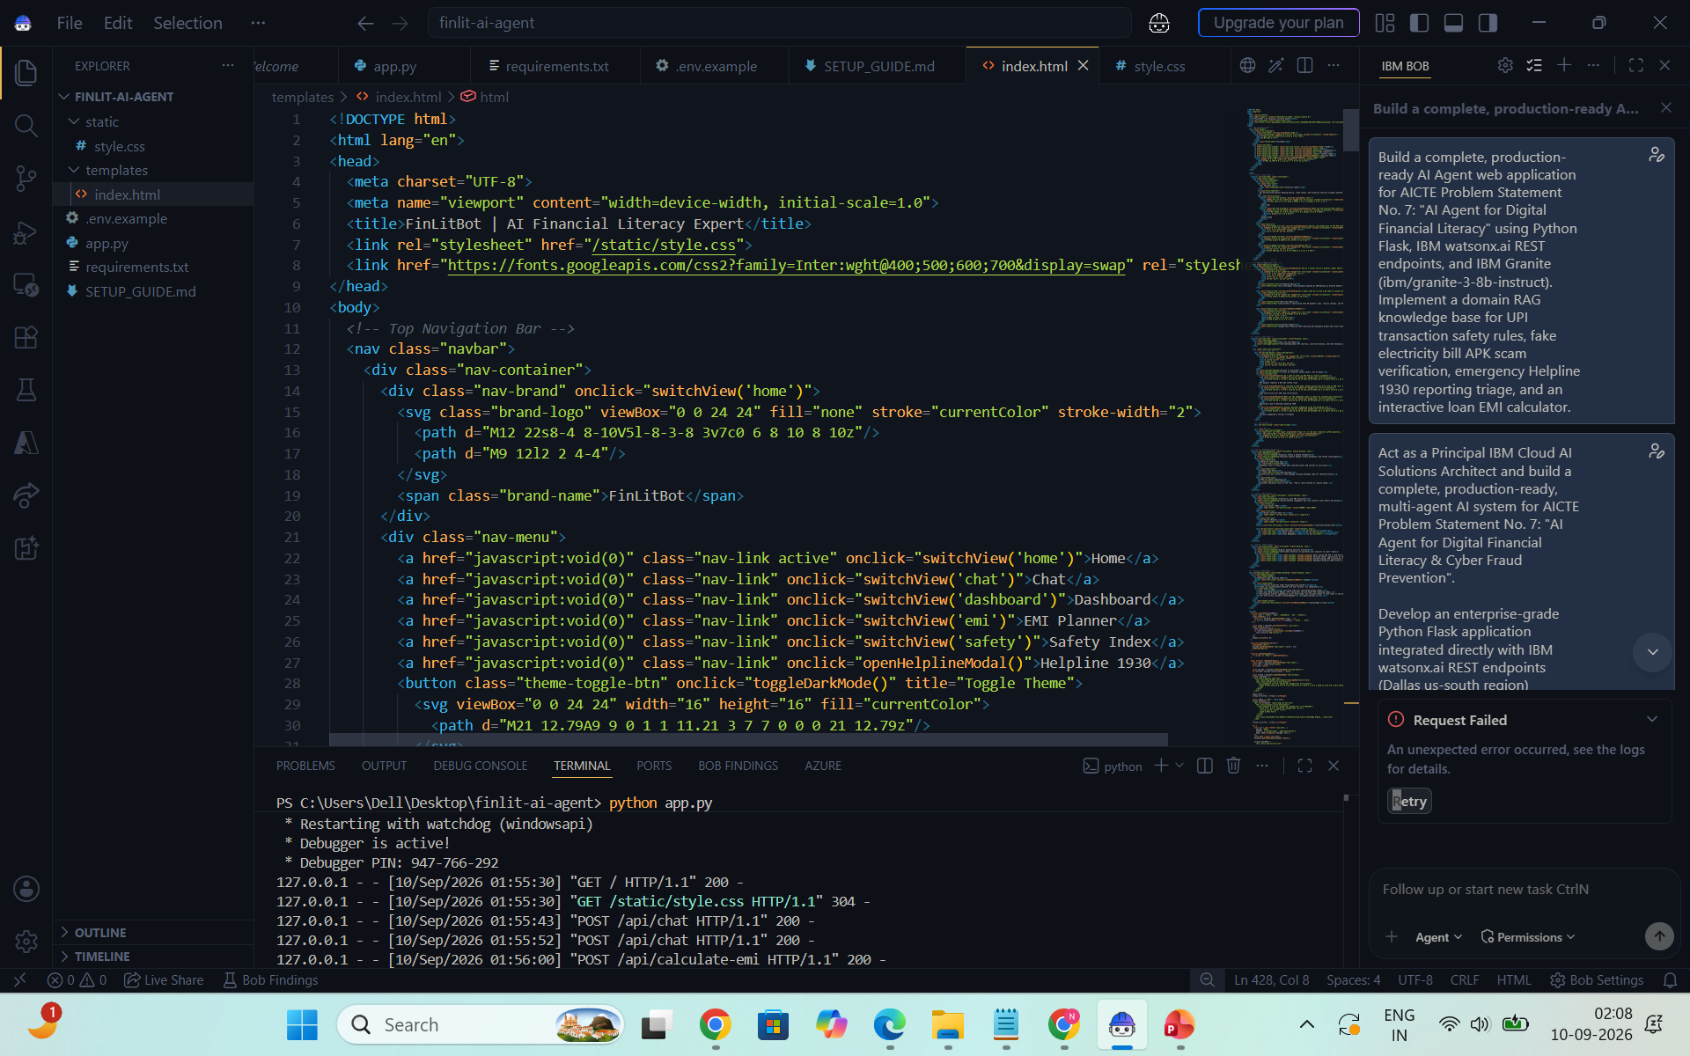

Slide 10
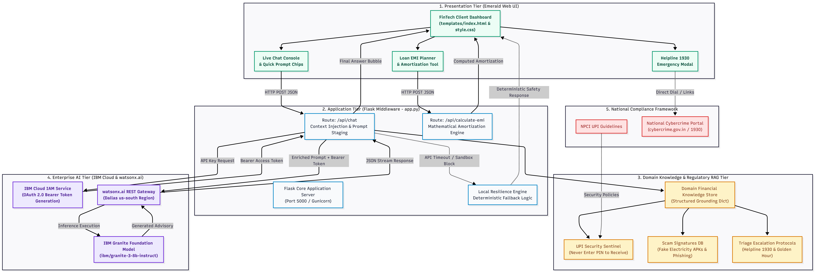
Architecture blueprint for IBM bob:

Slide 11
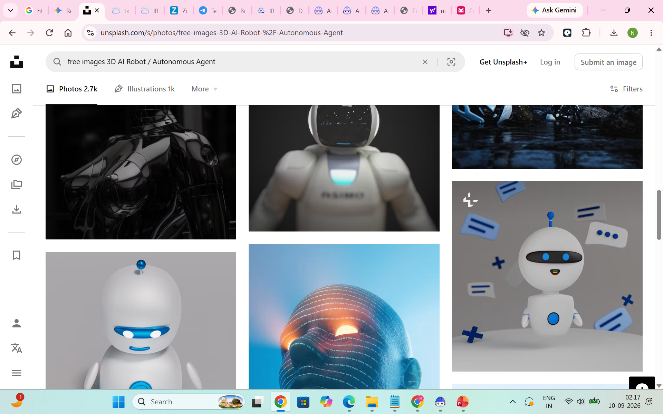
Role of Agentic AI in the solution
Role of Agentic AI in FinLitBot
Agentic AI transforms FinLitBot from a passive informational chatbot into an active, autonomous financial protection copilot. Powered by IBM watsonx.ai and IBM Granite models, the system dynamically interprets user intent, evaluates transaction risk, and coordinates specialized safety workflows in real time.
Autonomous Incident Triage: The system intelligently distinguishes between routine financial inquiries (such as CIBIL scores or budgeting) and active cyber fraud emergencies. Upon identifying an unauthorized money transfer, it bypasses generic advice to immediately initiate emergency triage—walking the victim through bank account freezes and National Cyber Crime Helpline (1930) reporting within the critical Golden Hour.
Multi-Agent Collaboration: Specialized agents collaborate seamlessly—the UPI Sentinel Agent verifies collect requests and QR codes, the Lending Advisory Agent computes transparent loan EMIs and checks RBI-registered lenders, and the Fraud Response Agent provides structured incident reporting steps.
Context-Aware Threat Interception: Rather than reciting static FAQs, the agent analyzes the user's specific context to intercept fraud before money is lost—flagging malicious electricity bill APK downloads and enforcing the golden rule that a UPI PIN is never entered to receive funds.
Grounded Regulatory Compliance: By coupling Granite's reasoning capabilities with a domain RAG knowledge base, the agent guarantees that all guidance strictly aligns with Reserve Bank of India (RBI) and NPCI consumer security standards.

Slide 12
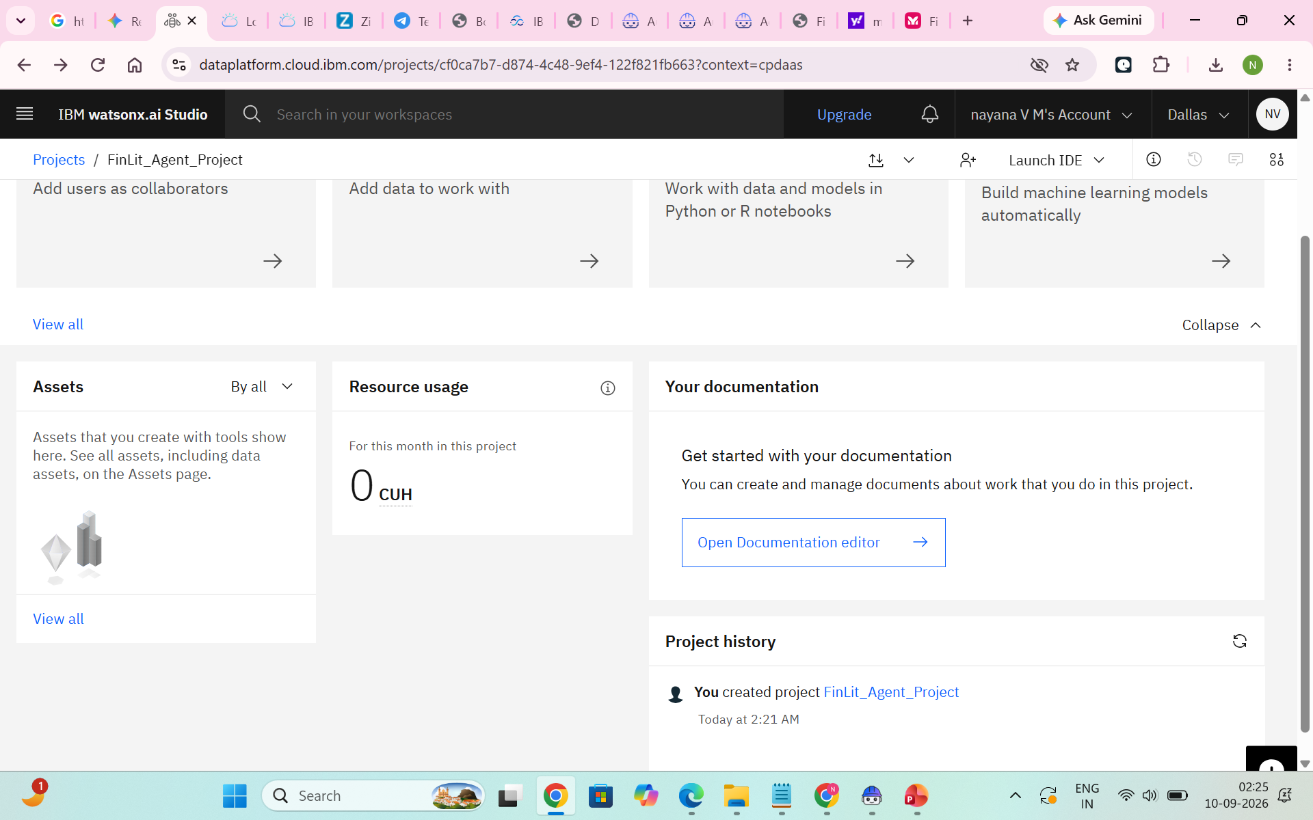
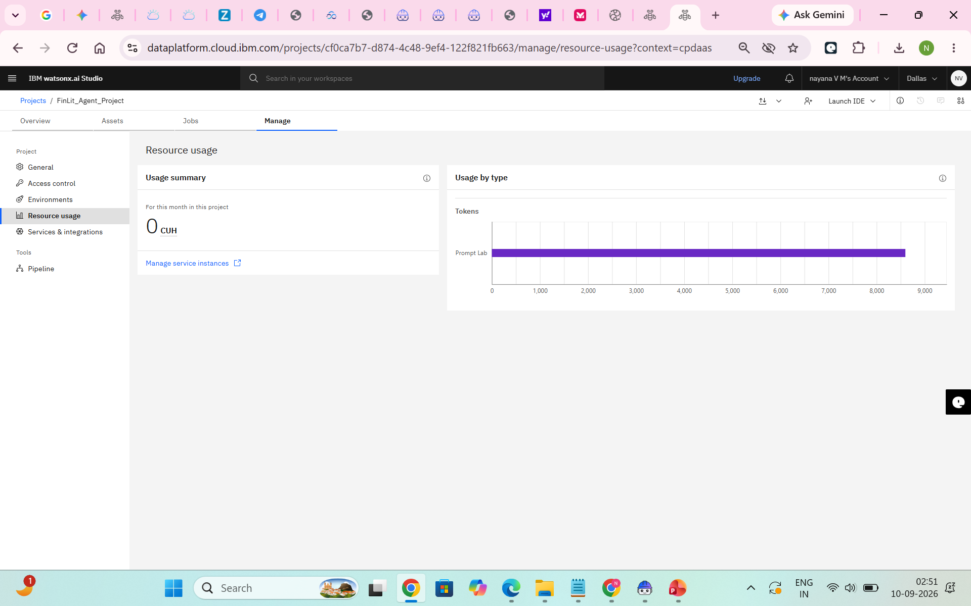
Token Usage
8,600 token are used
Before Prompt
After the Prompt
·
·
·

Slide 13
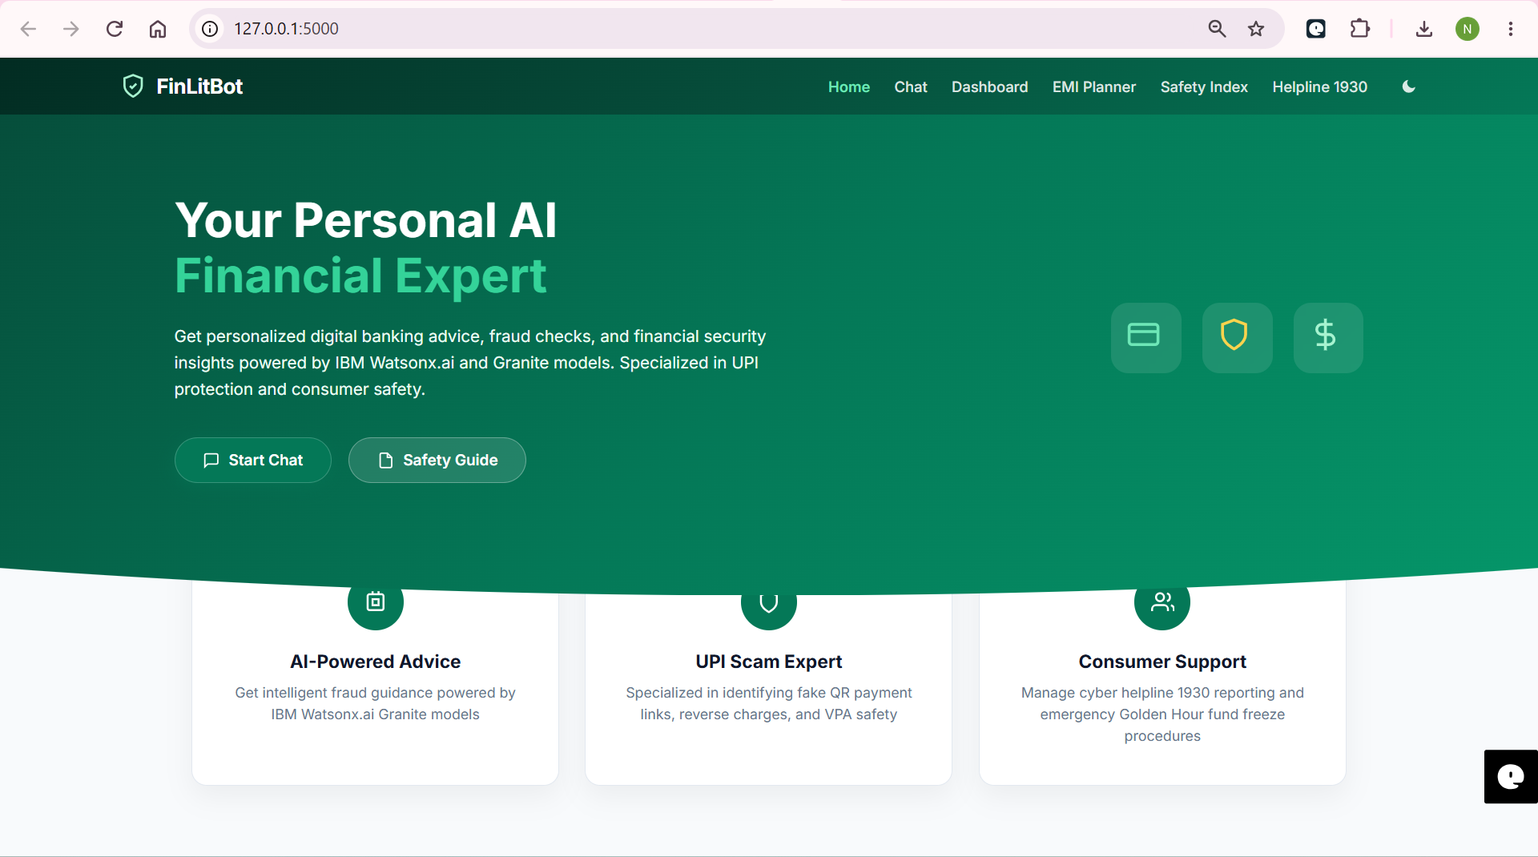
Project Output Screenshot
·
·
·

Slide 14
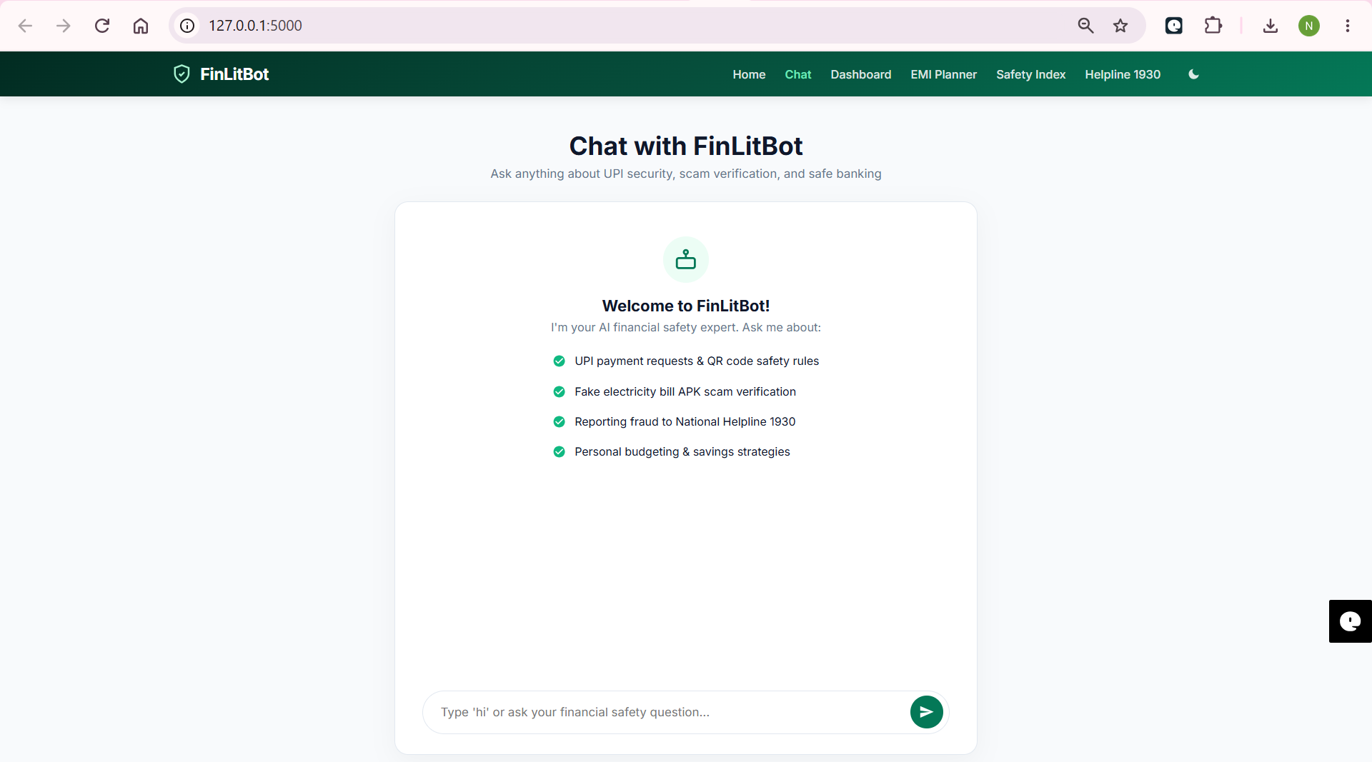
Project Output Screenshot
·
·
·

Slide 15
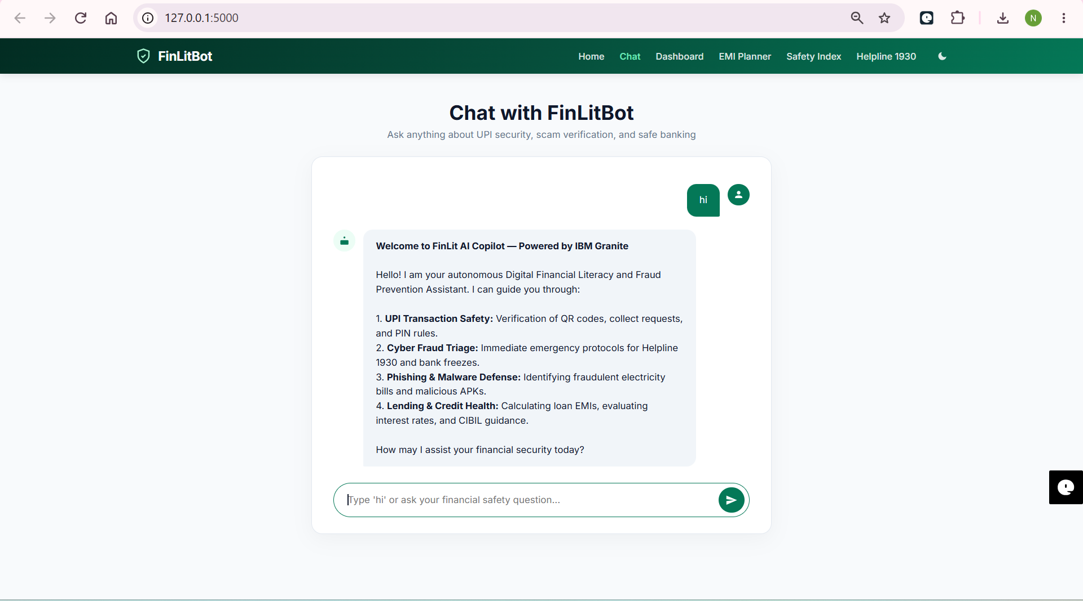
Project Output Screenshot
·
·
·

Slide 16
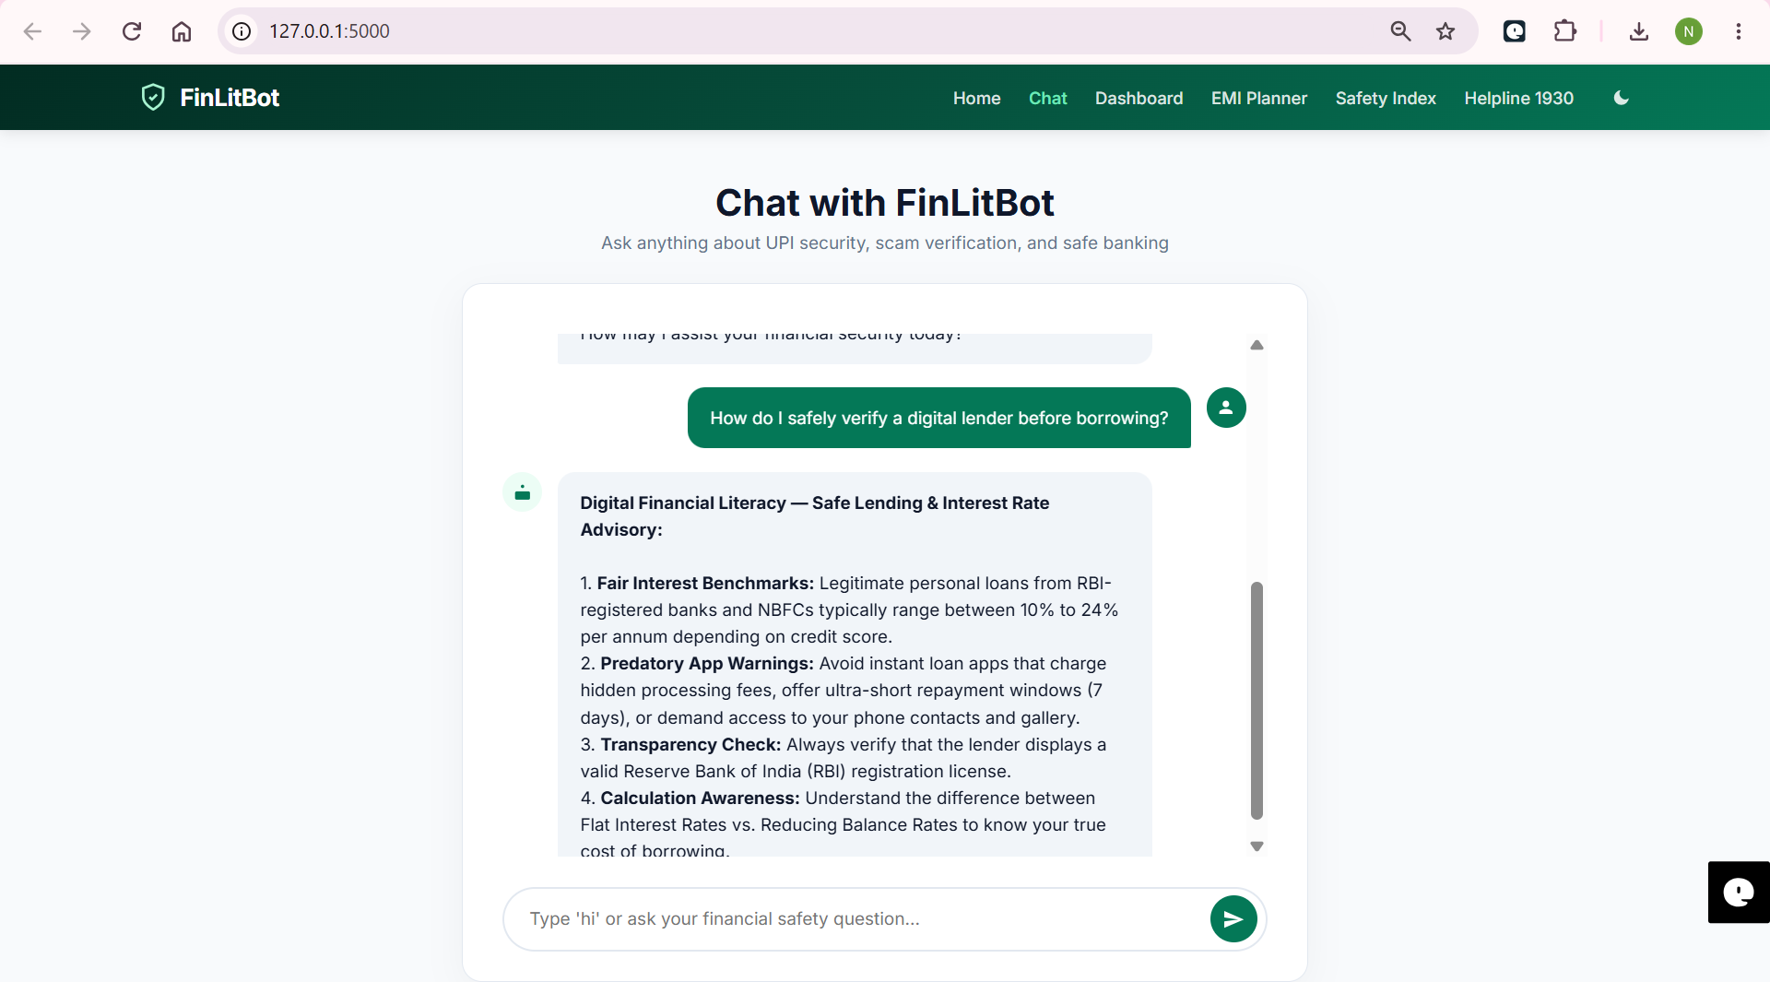
Project Output Screenshot
·
·
·

Slide 17
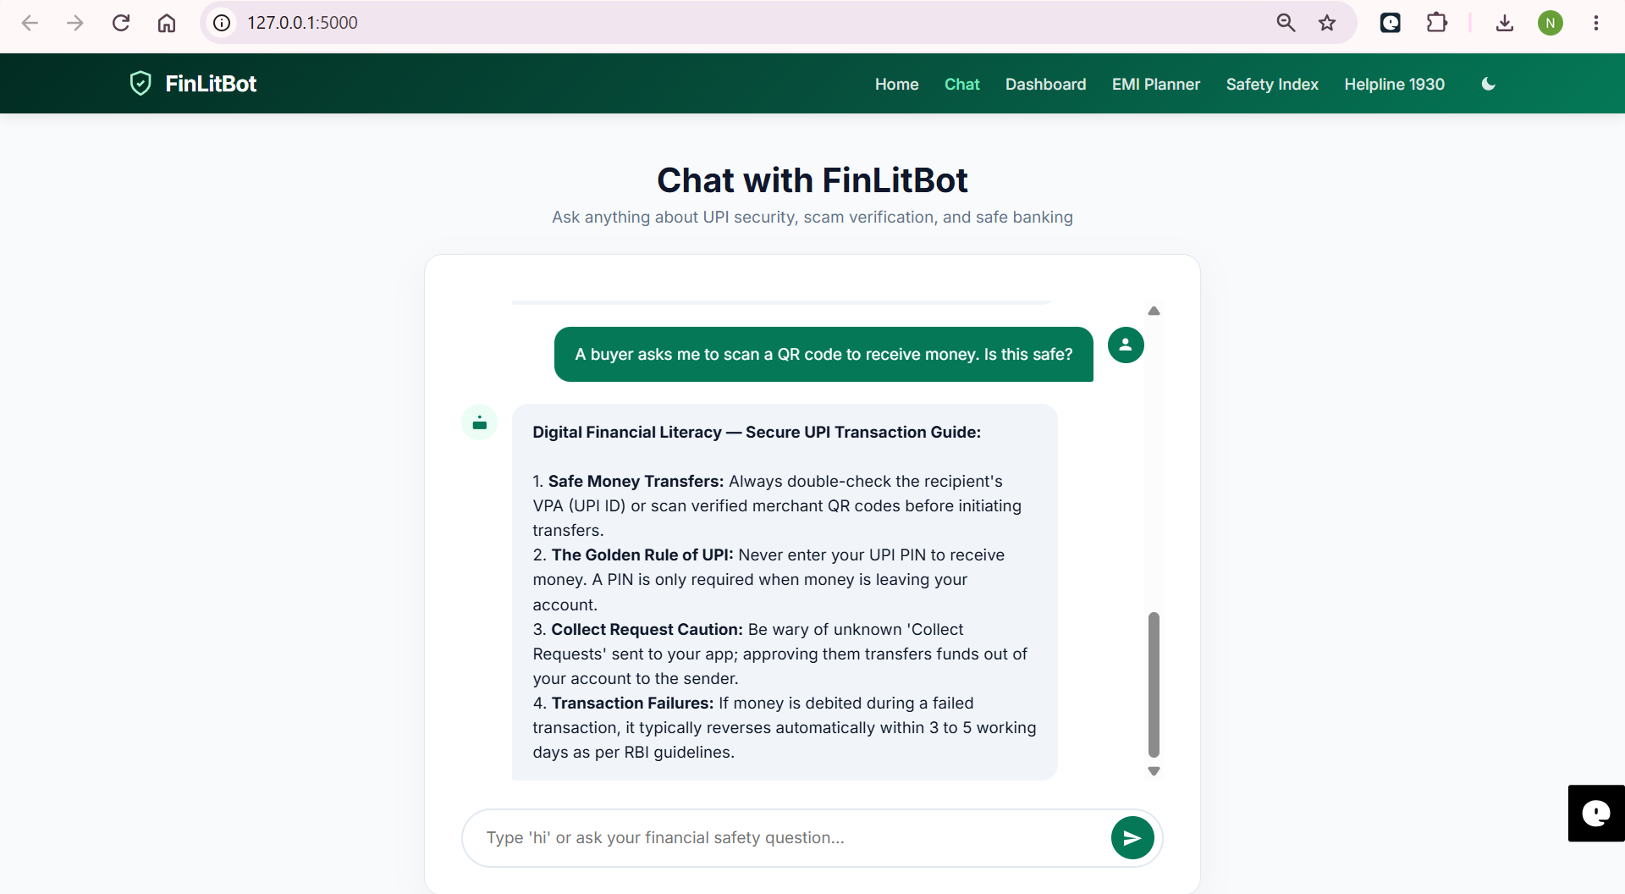
Project Output Screenshot
·
·
·

Slide 18
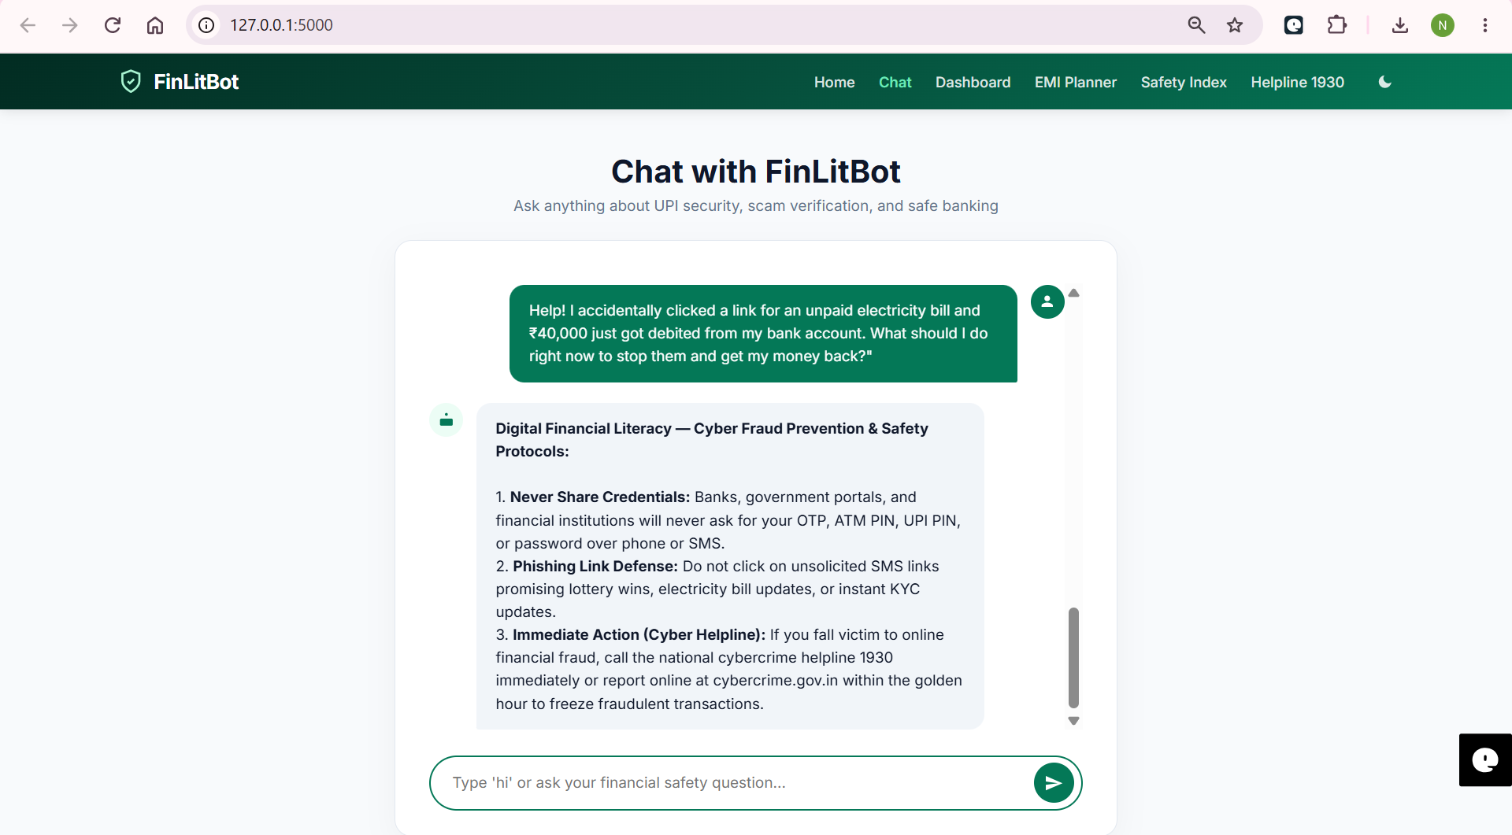
Project Output Screenshot
·
·
·

Slide 19
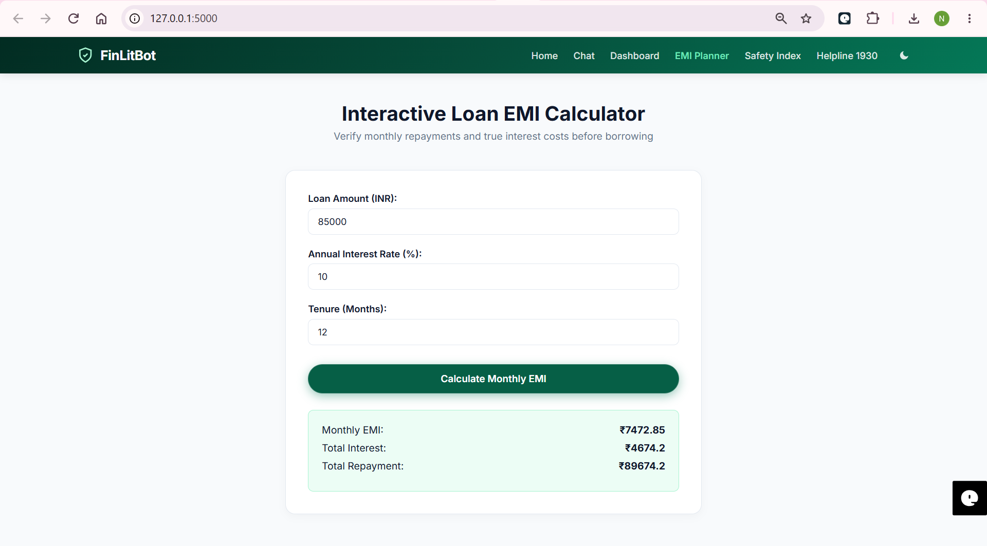
Project Output Screenshot
·
·
·

Slide 20
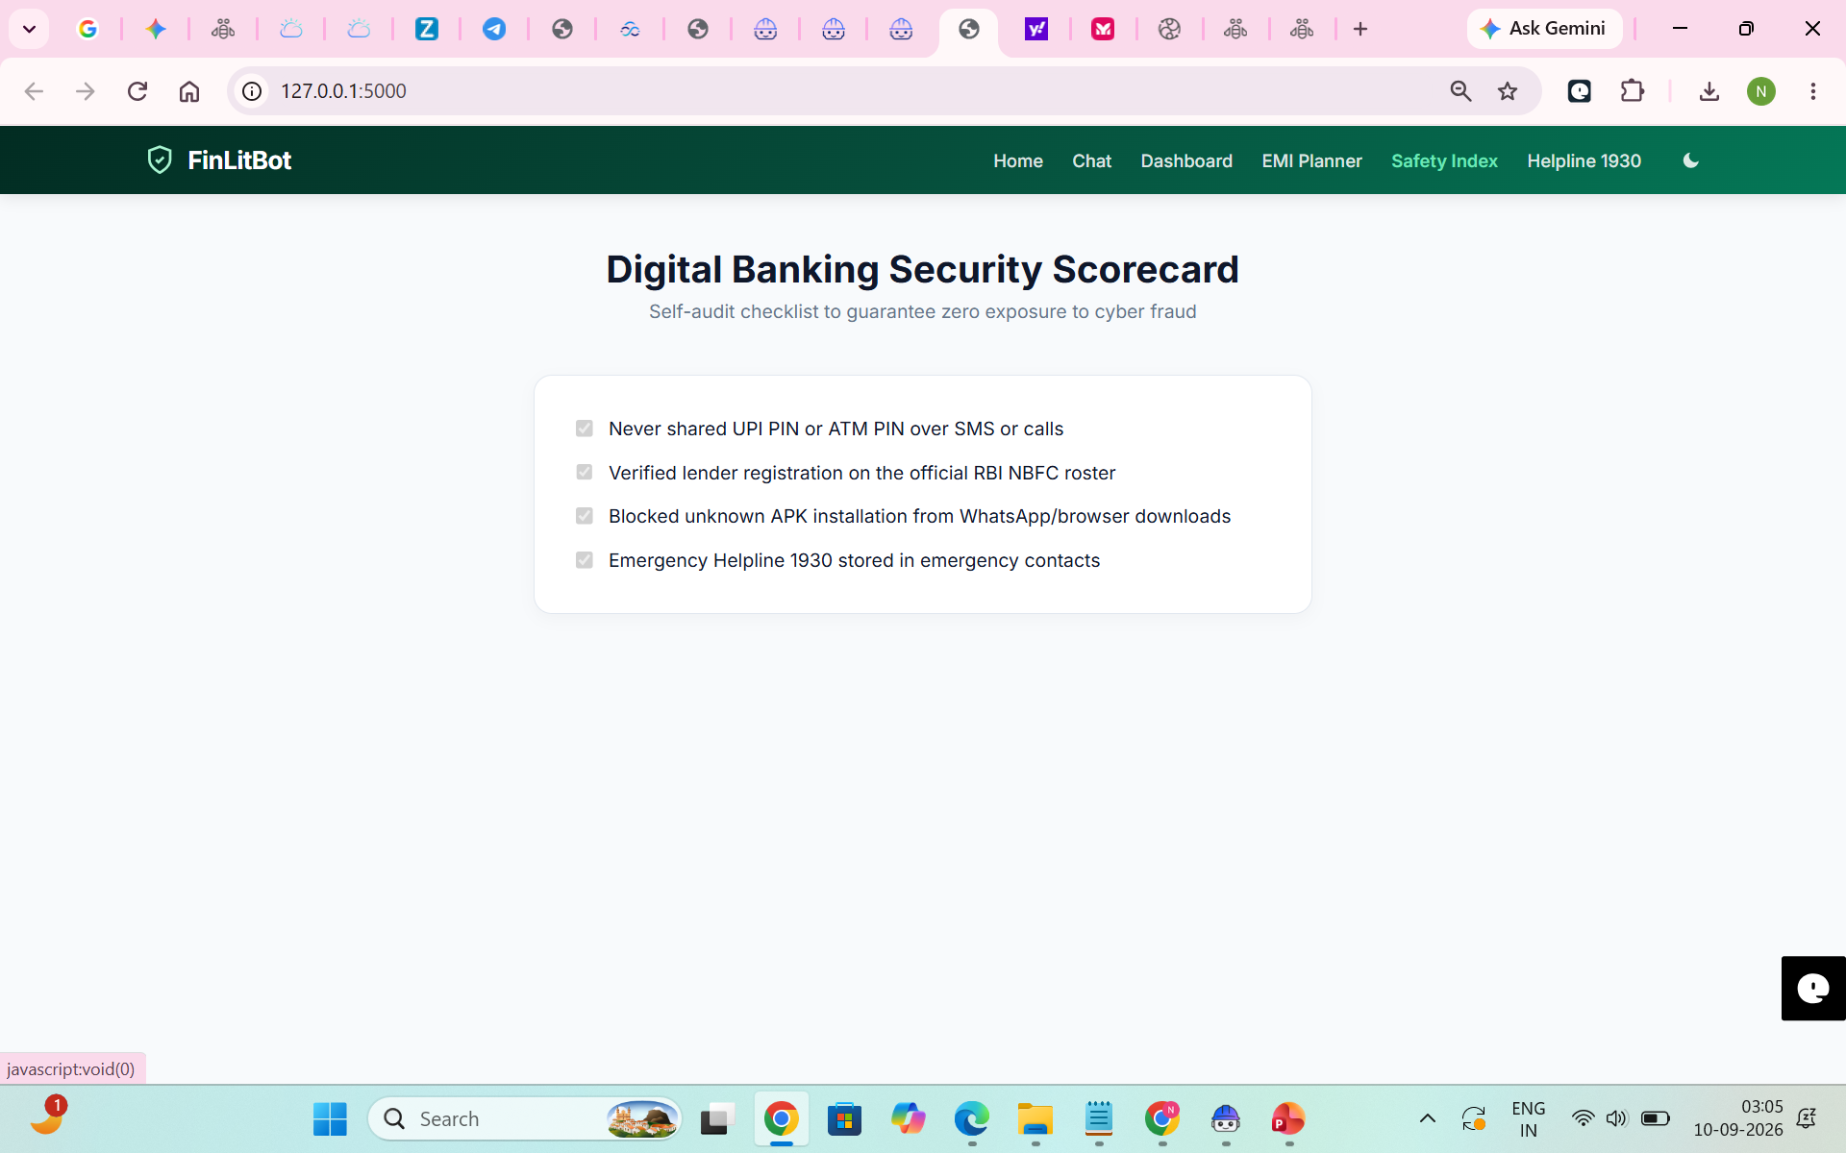
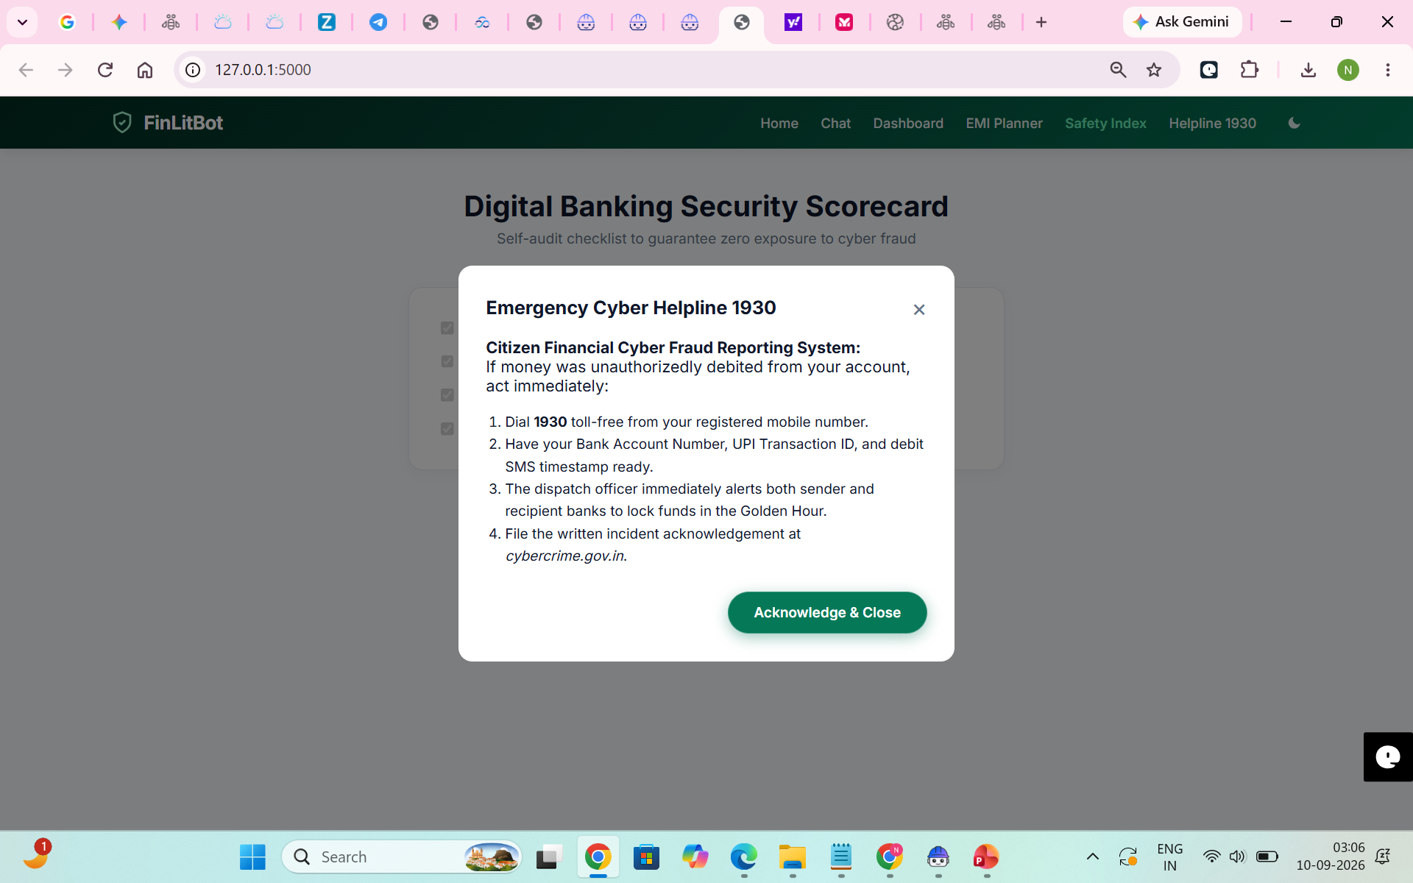
Project Output Screenshot
·
·
·

Slide 21
Novelty and Uniqueness
The proposed FinLitBot stands out by combining Agentic AI, RAG, and Real-Time Threat Interception into a proactive financial defense and literacy system.
Autonomous Incident Triage – Unlike static banking FAQ bots, FinLitBot initiates autonomous triage during the critical "Golden Hour" of cyber fraud, providing immediate escalation workflows for the National Cyber Crime Helpline (1930).
Context-Aware Threat Interception – Proactively detects social engineering cues (e.g., fake electricity bill SMS, QR code debit requests, remote access APKs) and intervenes to prevent credential/PIN leakage before a transaction occurs.
RAG-Grounded Regulatory Accuracy – Uses Retrieval-Augmented Generation anchored to official RBI guidelines, NPCI standards, and cybercrime reporting protocols, eliminating hallucinations and ensuring legally sound guidance.
Bi-Directional Security Guardrails – Intercepts sensitive personal identifiable information (PII) and account credentials at the input layer before queries reach the model API, maintaining complete data privacy.
Automated Dispute Resolution – Bridges guidance into action by structuring incident details for formal FIR registration on cybercrime.gov.in and lodging complaints under the RBI Integrated Ombudsman Scheme.
Enterprise-Ready & Scalable – Built natively on IBM watsonx.ai utilizing IBM Granite (ibm/granite-3-8b-instruct) for enterprise governance, verifiable token metrics, and compliant audit trails.

Slide 22
Git Hub Link
Public Repository URL:
[https://github.com/Nayana-vm/FinLitBot-IBM-watsonx](https://github.com/Nayana-vm/FinLitBot-IBM-watsonx)
(Public repository verified — accessible without login credentials)
Uploaded Deliverables & Repository Structure:
IBM Cloud & Agent Core Files:
app.py – Complete Flask middleware routing with input PII sanitization, Golden Hour keyword interceptor, and IBM watsonx.ai REST integration.
templates/index.html & static/style.css – Responsive web console featuring real-time chat, UPI Safety Index, and loan EMI calculator.
requirements.txt & .env.example – Production dependencies (ibm-watsonx-ai, flask, python-dotenv) and environment configuration template.
Problem Statement Document:
docs/yourproblemstatement.pdf – Formal problem statement documentation for Track #7: AI Agent for Digital Financial Literacy & Cyber Fraud Prevention.
Project Final Presentation:
AICTE_IBM_BOB_Project_Submission_Template_for_EduentFoundation_.pptx – Complete final presentation deck with architecture diagrams, watsonx token metrics, and output screenshots.
Detailed Technical Documentation (README.md):
Active Local Endpoints: Documented for http://localhost:5000/ and [http://127.0.0.1:5000/](http://127.0.0.1:5000/).
watsonx Model Specs: Details for ibm/granite-3-8b-instruct, Dallas (us-south) region, and Project ID cf0ca7b7-d874-4c48-9ef4-122f821fb663.
Resource Usage Verification: Breakdown of the ~8,600 Prompt Lab tokens consumed on IBM Cloud.
·
·
·

Slide 23
Future Scope
1. Direct CFCFRMS & Open Banking API Integration – Integrating FinLitBot directly with banking APIs via the Account Aggregator (AA) framework and the Citizen Financial Cyber Fraud Reporting and Management System (CFCFRMS). This will enable one-click automated transaction freezing and instant suspect account blacklisting during the critical Golden Hour, advancing the agent from guided triage to direct, user-authorized emergency intervention.
2. Vernacular Voice-First Assistant & Dialect Support – Deploying multilingual speech-to-speech AI models to support major Indian regional languages (Hindi, Kannada, Tamil, Telugu, Marathi, and Bengali). This will bridge the digital divide for semi-urban and rural demographics—frequent targets of UPI social engineering scams—allowing users to report fraud and receive instant guidance entirely through voice commands.
3. Proactive Mobile Threat & Malicious APK Scanner – Expanding FinLitBot into an on-device mobile companion utility that scans incoming SMS payloads for phishing links, warns against suspicious e-challan/utility APK downloads, and automatically flags active screen-sharing apps (such as AnyDesk or TeamViewer) whenever banking or UPI applications are running.
·
·
·

Slide 24
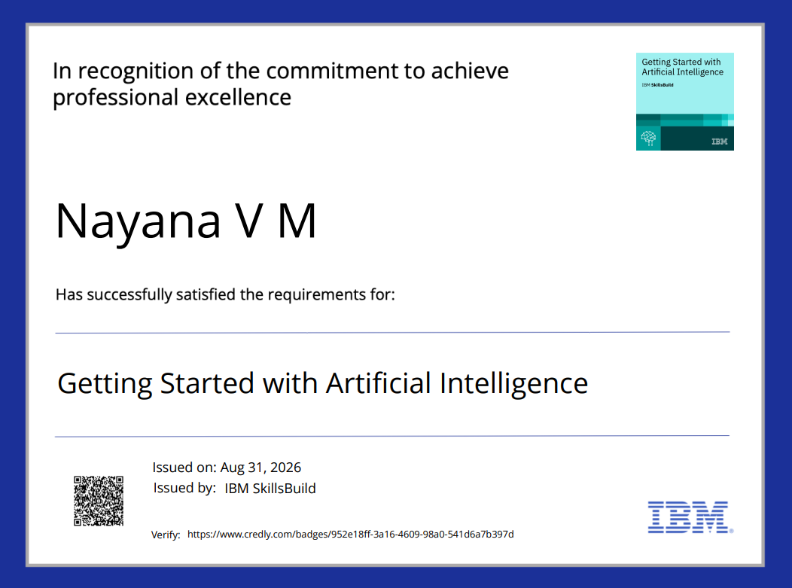
Certificates Earned:
Credly certificate(Getting Started with Artificial Intelligence)

Slide 25
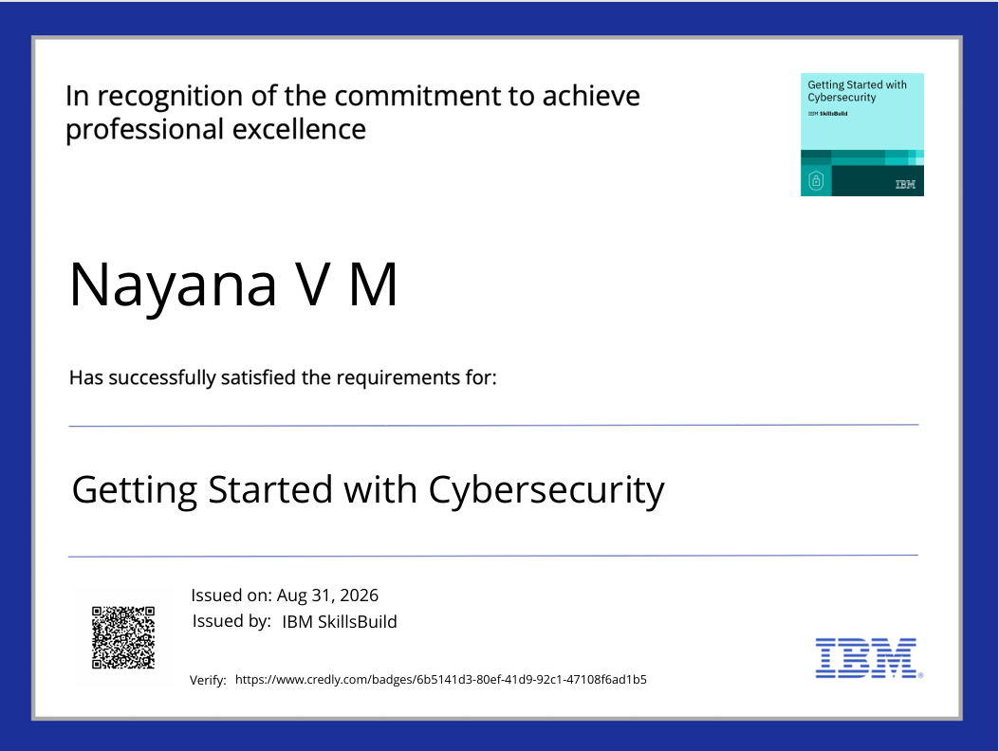
Certificates Earned:
Credly certificate(Getting Started with Cybersecurity)

Slide 26
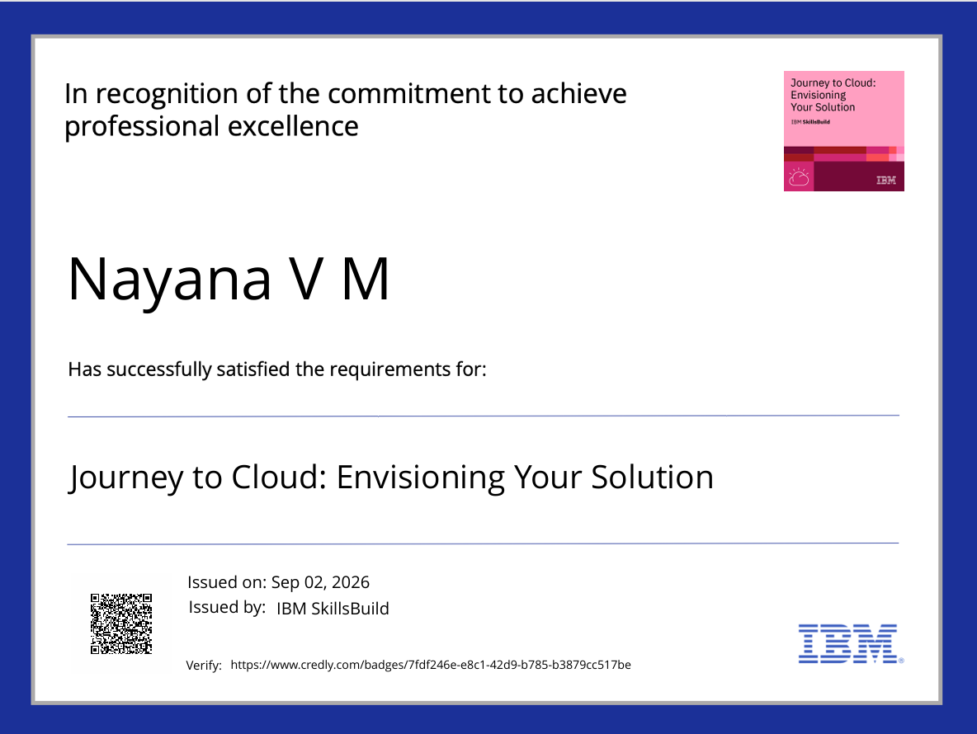
Certificates Earned:
Credly certificate(Journey to cloud :Envisioning your solution)

Slide 27
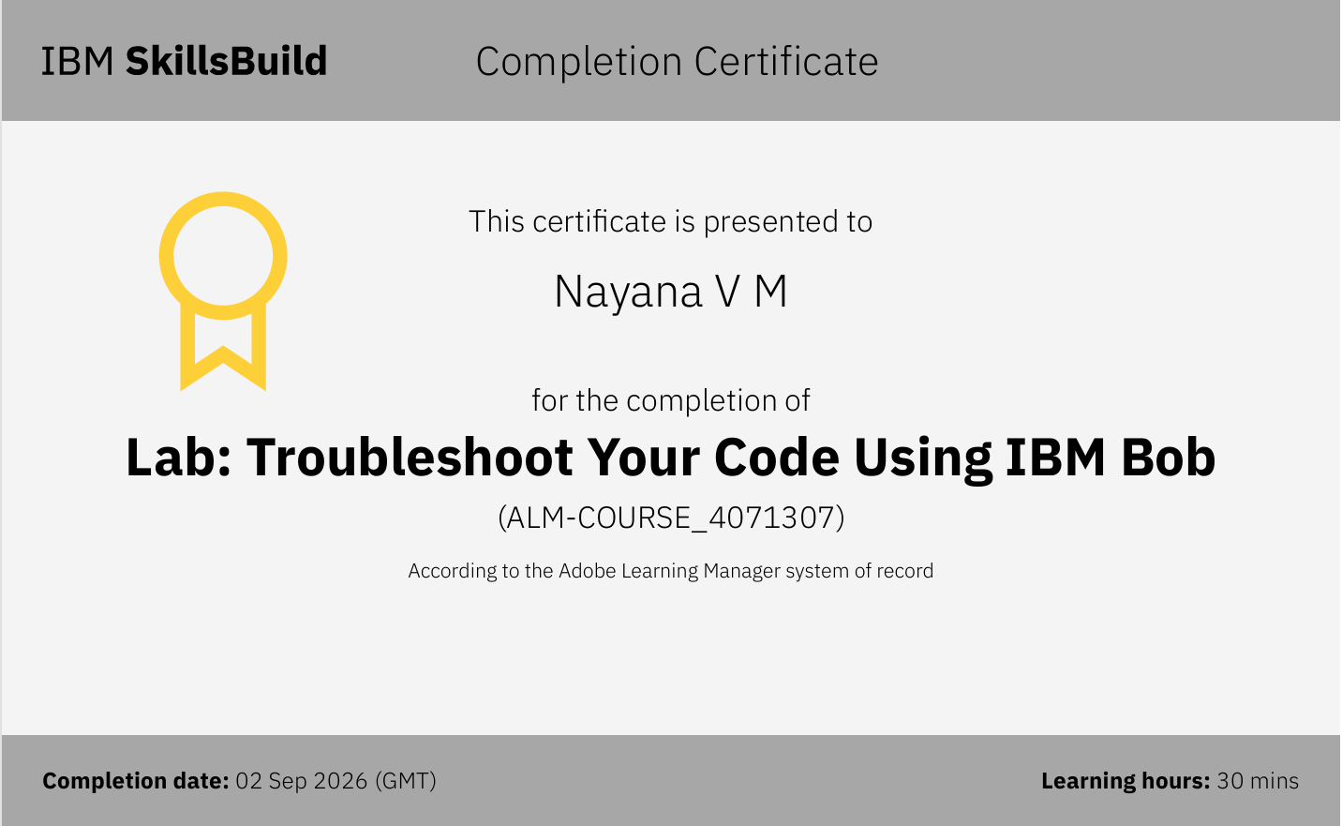
Certificates Earned:​
IBM BOB Certificate

Slide 28


